Slide 1


Adversarially Learned Anomaly Detection using Generative Adversarial Networks
School of Industrial and Information Engineering
Master of Science in Computer Science and Engineering
Academic Year 2018 - 2019
Candidate: Şemsi Yiğit Özgümüş
Supervisor : Giacomo Boracchi
Notes:
Hello everyone, my name is Yiğit Özgümüş and today I will be presenting you my thesis
“Adversarially learned Anomaly Detection Using Generative Adversarial Networks”.

Slide 2


What is Anomaly Detection ?
Samples that don’t follow the characteristic behaviors of the defined notion of normality
Cyber security
Finance
Healthcare
Manufacturing
1
Notes:
I would like to start by defining what anomaly detection is.
Anomaly detection is finding samples that don’t follow the characteristic behaviors of the defined notion of normality
However in practice, only the data for the problem is present.
Notion of normality is discovered by means of modeling the available data.
Anomaly detection is a heavily researched topic because it can be applied to variety of application domains.
Such as cybersecurity, finance, healthcare and manufacturing.
Nowadays, problems investigated in these areas more and more depend on solutions which based on data driven models
And finding anomalies in data translate into usable and actionable information that may be beneficial for the solution of those problems

Slide 3
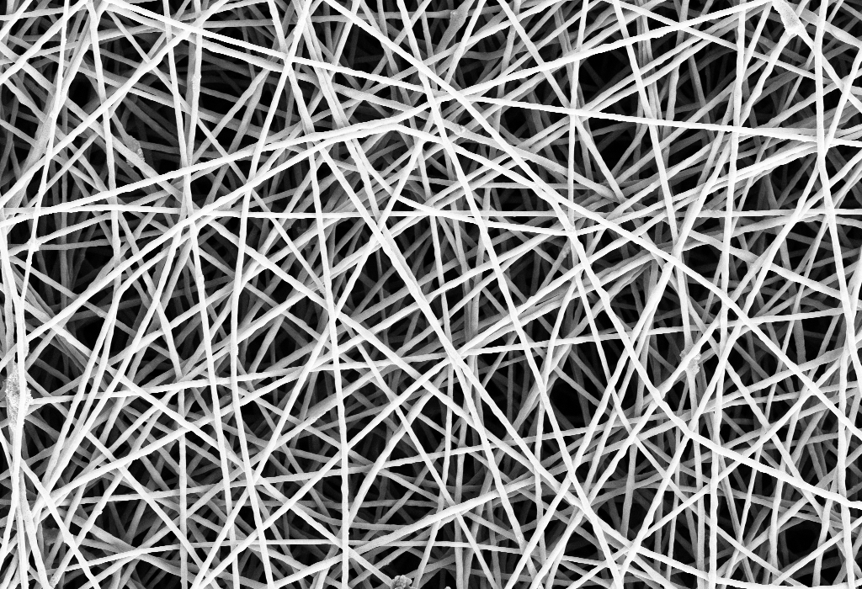
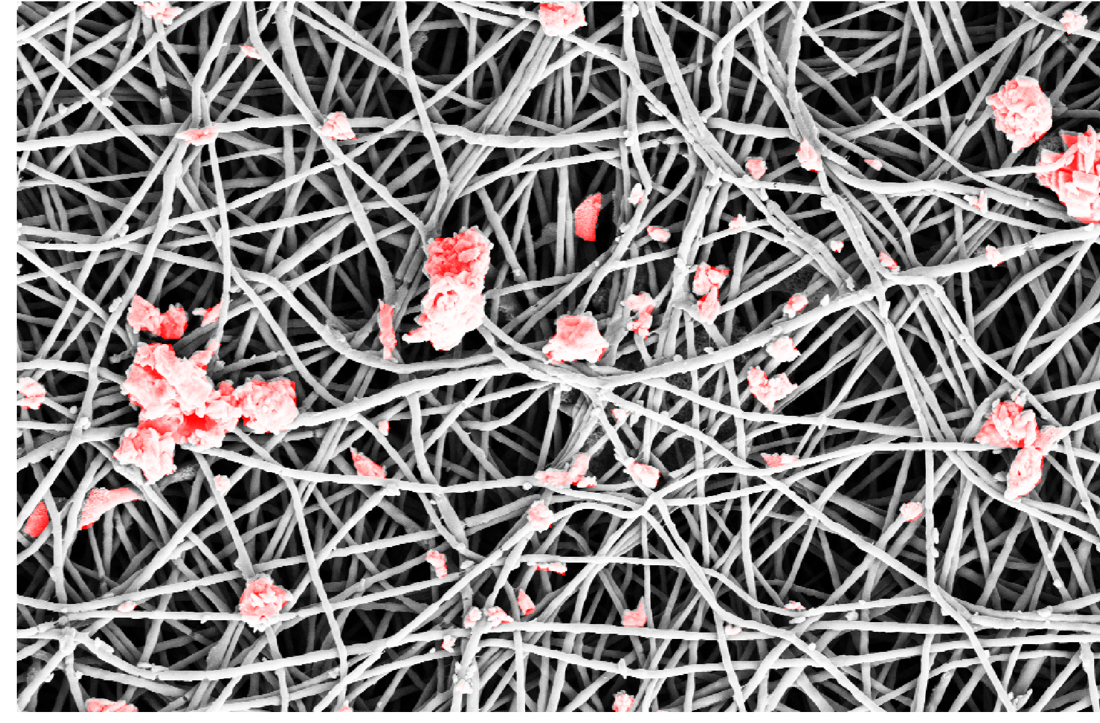
Problem focus of This Thesis
Nanofibrous material production monitoring
Detection of defective regions occurred in the production process due to external factors
Detection of anomalies are required to monitor quality of batches and to prevent waste
2
POLITECNICO DI MILANO
Notes:
The problem this thesis investigates is the anomaly detection in nanofibrous material production.
Due to the sensitivity of the production process, anomalous regions with various shapes and sizes may be formed between the filaments
Detection of these anomalies are required
to maintain a certain quality standard in production line
and also to prevent waste of materials.
To give an example,

Slide 4
Problem focus of This Thesis
3
POLITECNICO DI MILANO
Notes:
This is an image of the material with no anomalous regions

Slide 5
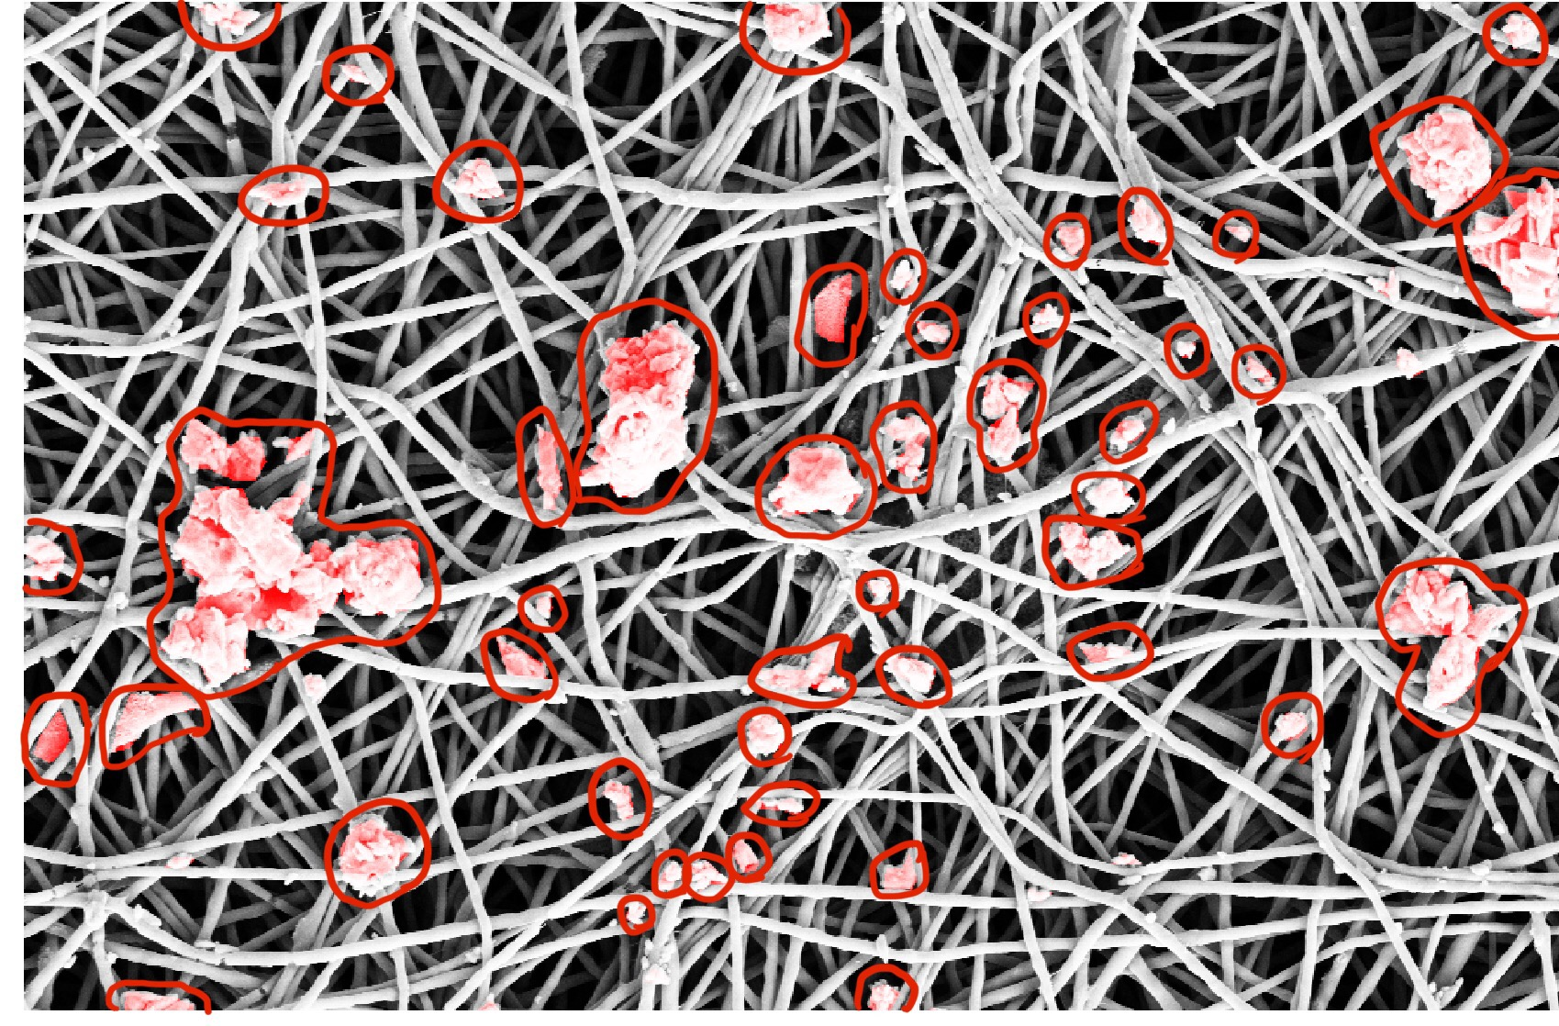
Problem focus of This Thesis
4
POLITECNICO DI MILANO
Notes:
And this is an image with various types of anomalous regions.
As you can see, Anomalies have no defining characteristics
İn terms of shape and size

Slide 6
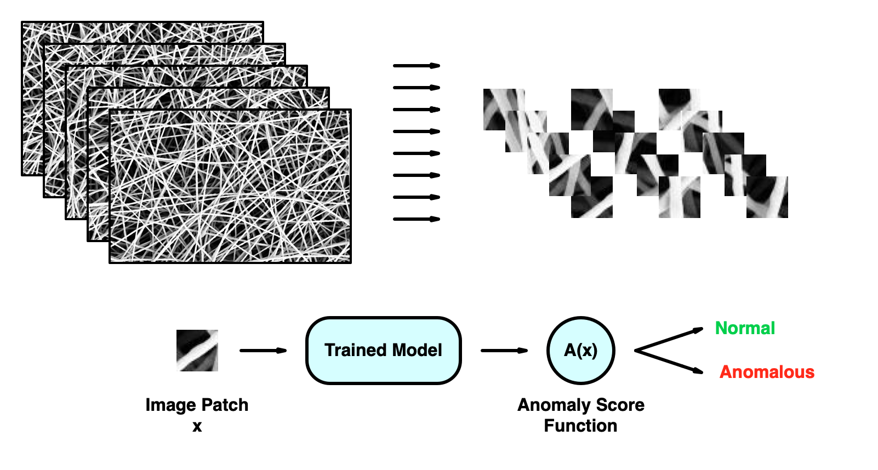
Problem focus of This Thesis
5
POLITECNICO DI MILANO
Notes:
In our problem, we work with image patches instead of whole images for the detection
Notion of normality is learned by training a model
Patches are extracted from the images randomly to train the model but extracted in order for anomaly detection phase
Using an anomaly score function and our trained model, we determine whether a patch contains anomalous region or not.

Slide 7
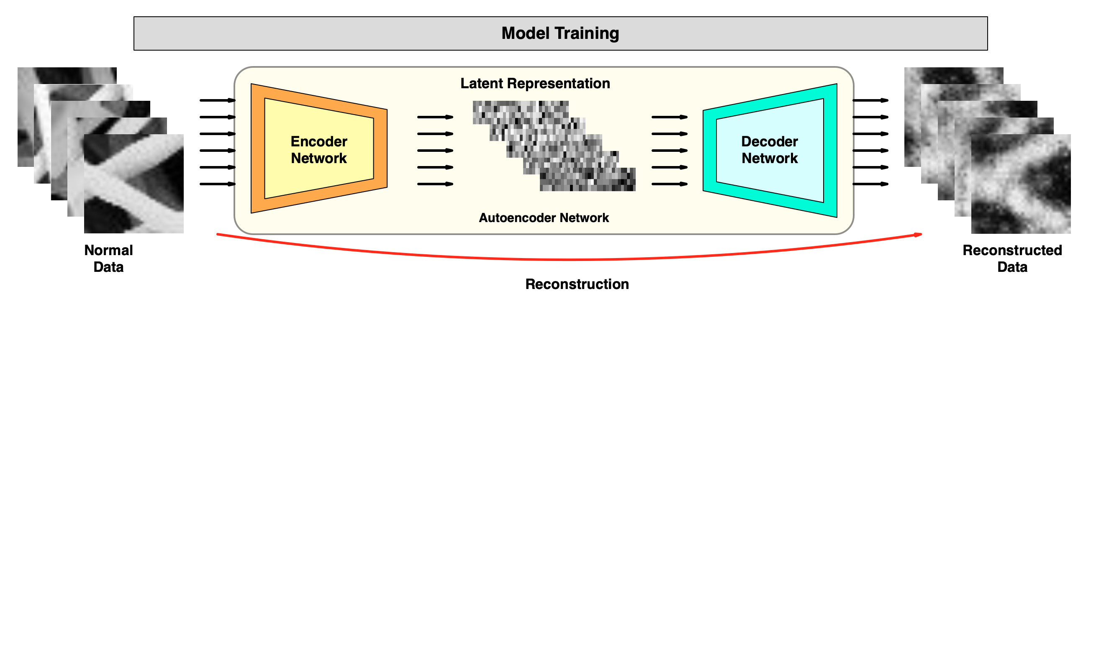
Reconstruction Based Anomaly Detection
Mapping from image space to latent dimension space
Reconstruction from latent representation
Computing score from the information loss
6
POLITECNICO DI MILANO
Notes:
When the normal and anomalous sample sizes are imbalanced, just like in our problem, reconstruction based methods are preferred.
Main premise is that detecting anomalies on higher dimensional feature space such as images
becomes easier if the underlying normal data lies in a subspace of lower dimensionality like its original form.
Autoencoder networks are heavily used for this anomaly detection method.
Autoencoders consists of an encoder and decoder network.
Encoder maps the high dimensional data to a latent space and decoder reconstructs data from this latent representation.
They are trained in a way to minimize the difference between the actual sample and its reconstruction so the learned latent representation contains the most salient features of the image.

Slide 8
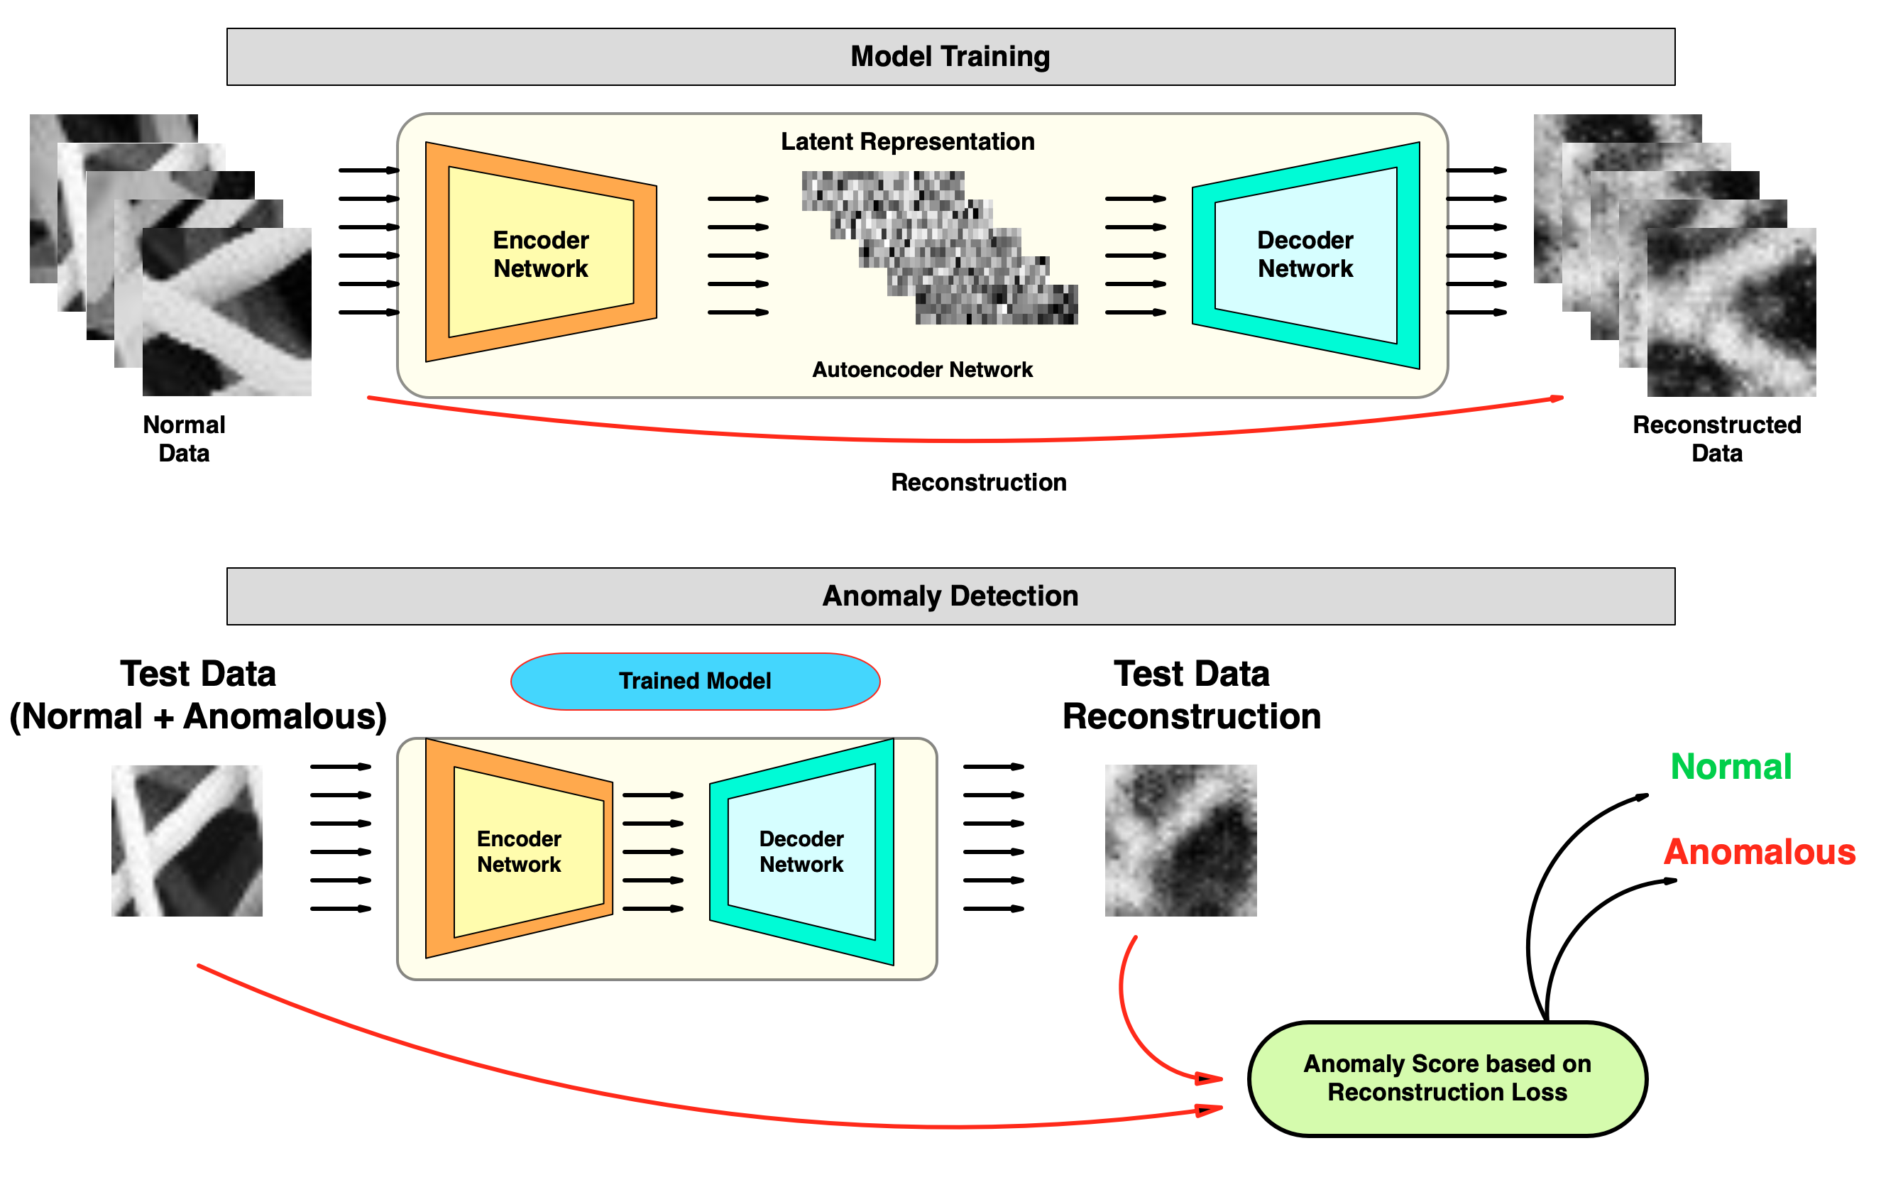
Reconstruction Based Anomaly Detection
7
POLITECNICO DI MILANO
Notes:
Anomaly detection is performed by applying the reconstruction operation on a test patch.
Since the model is trained on the normal data, defined reconstruction loss will be higher with anomalous samples
and anomaly score defined using this reconstruction difference can detect whether the test samples is anomalous or not
by comparing that score to a threshold value

Slide 9
What is Generative Adversarial Network ?
POLITECNICO DI MILANO
Notes:
Next I would like to introduce generative adversarial networks.

Slide 10

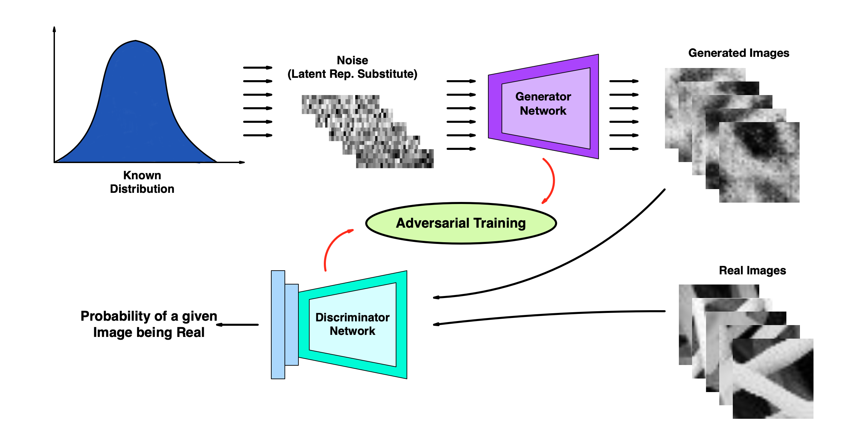
What is Generative Adversarial Network* ?
Network pair trained adversarially using a mini max game
Generator learns the generate data similar to target data’s distribution
Mapping from latent dimension to higher dimension is learned
* Ian J. Goodfellow et al. “Generative Adversarial Nets NIPS’14. Montreal, Canada: MIT Press, 2014
8
POLITECNICO DI MILANO
Notes:
Generative adversarial networks are considered as one of the most significant breakthroughs in deep learning and generative modeling in recent years
This framework can generate realistic data similar to given training data
It achieves that by learning the mapping from a known latent noise to the image distribution of training data using unsupervised training.
Generator network is responsible for generating image similar to the training data
Discriminator on the other hand is responsible for differentiating the real and the fake images
It outputs the probability of a given image being real.

Slide 11
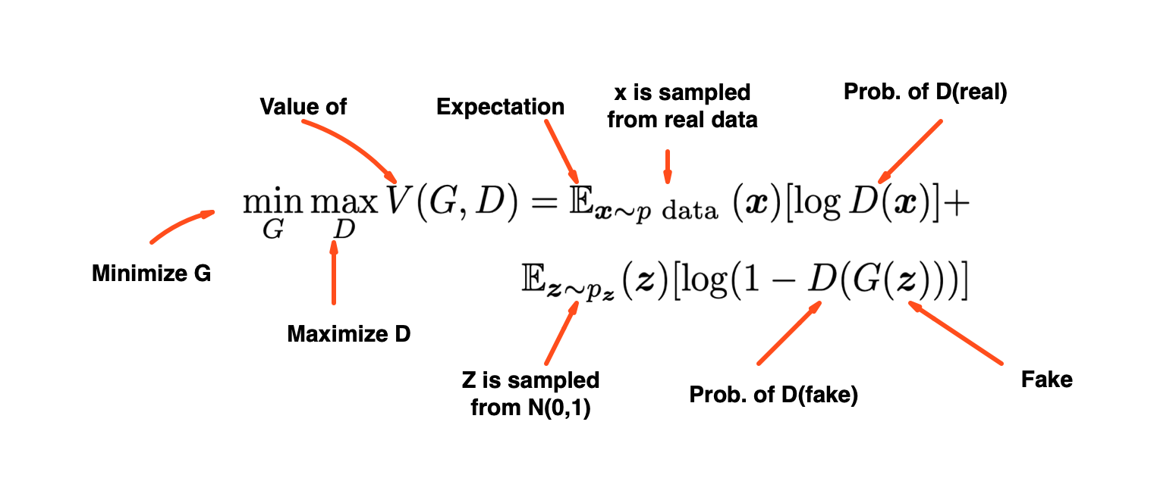
What is Generative Adversarial Network ?
Training objective of GAN:
9
POLITECNICO DI MILANO
Notes:
Training objective of the gan is this equation
It is an alternating minimax game played between the two networks
Terms are composed of discriminator’s evaluation of real and generated images

Slide 12
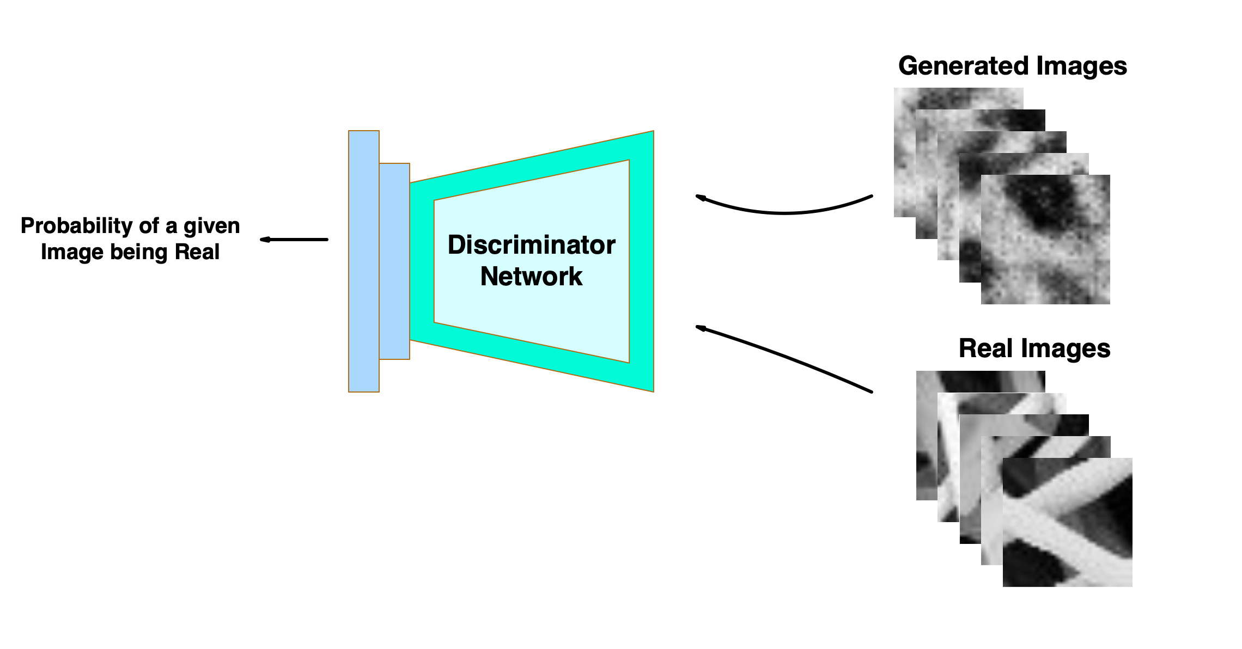
What is Generative Adversarial Network ?
Perspective of Discriminator Network:
Real samples classified as being real
Discriminator wants to maximize this
Generated samples classified as being fake
Discriminator wants to minimize this
10
POLITECNICO DI MILANO
Notes:
If we direct this equation
From the discriminator’s perspective, it needs to maximize these outputs.
Discriminator learns the detect real images as real by maximizing the first term
And improves detecting generated images as fake by maximizing the second term
Since it’s inverted, it actually minimizes the probability output for fake images

Slide 13
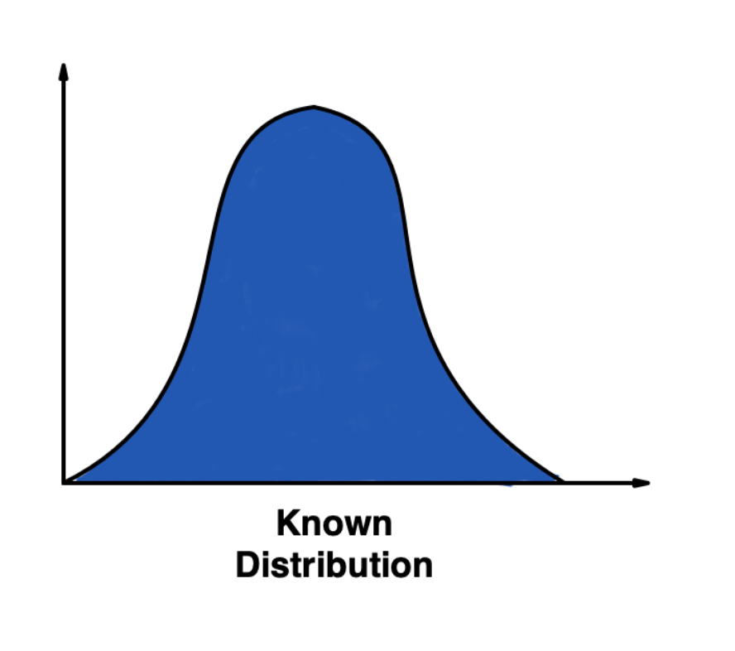
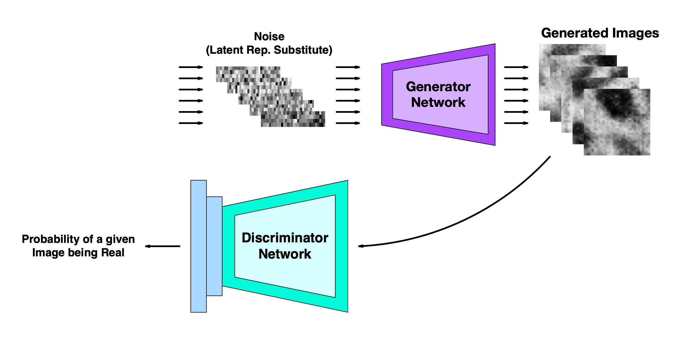
What is Generative Adversarial Network ?
Perspective of Generator Network:
How realistic are the generated samples ?
Generator wants to maximize this
11
POLITECNICO DI MILANO
Notes:
Generator interprets this equation as how realistic are the generated samples. So it only deals with second term.
Generator wants to increase the output that discriminator assigns for generated images
So it maximizes the probability output by minimizing the term

Slide 14
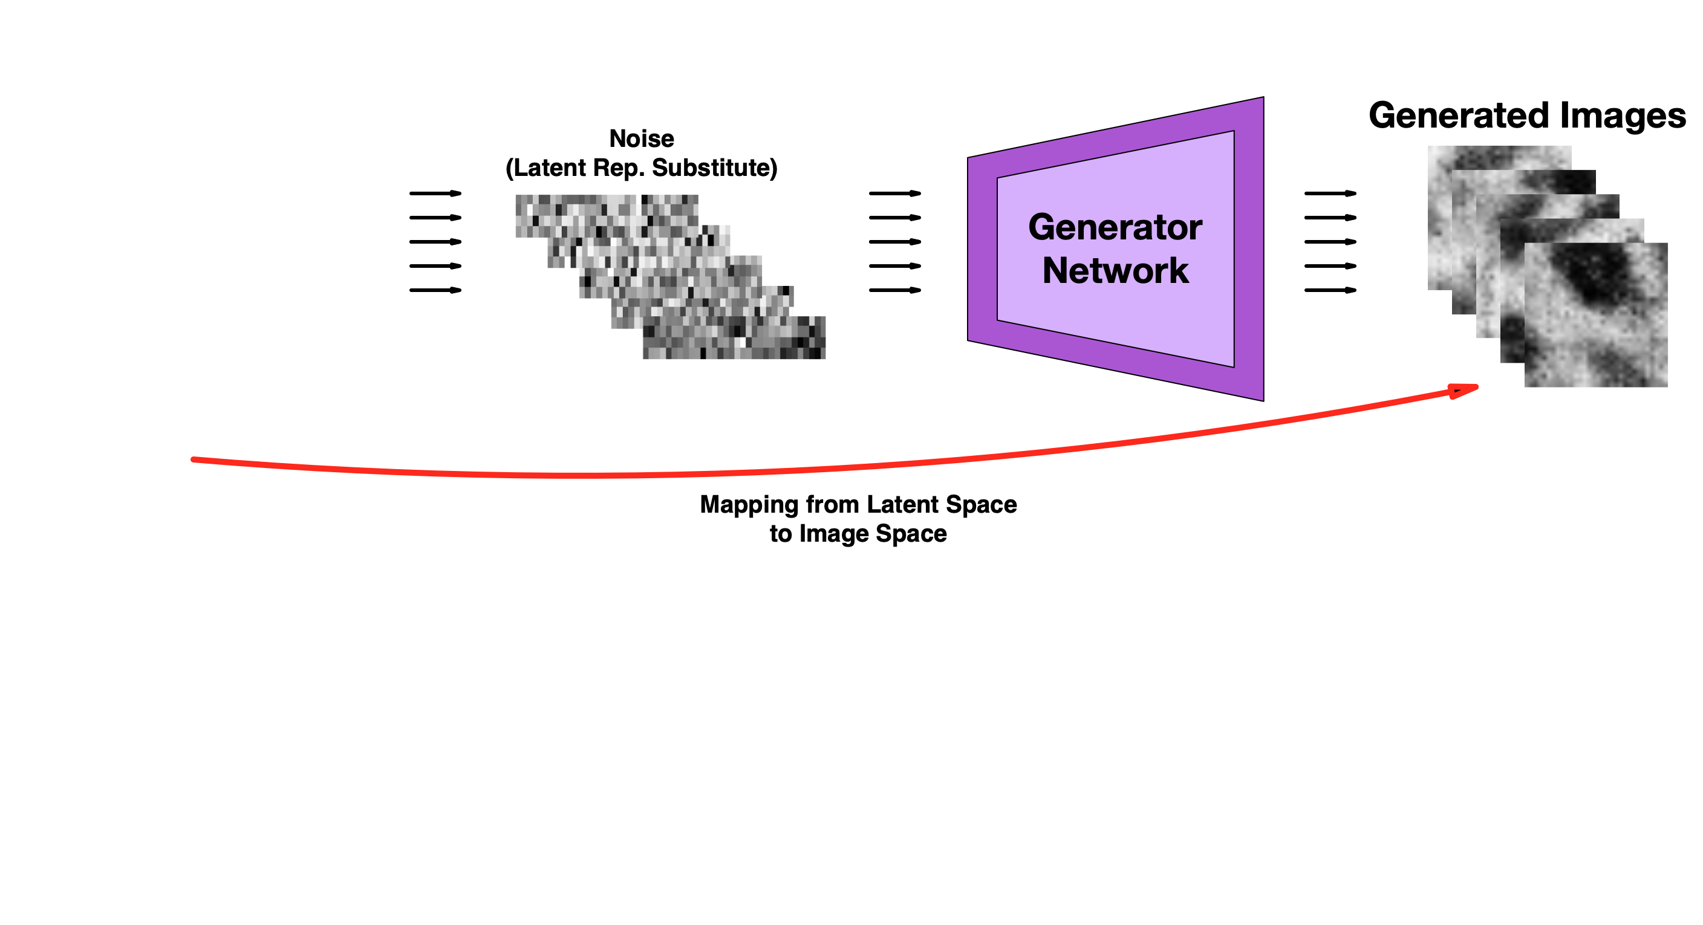
Motivation Behind Using GANs
12
POLITECNICO DI MILANO
Notes:
The main motivation behind studying gan for anomaly detection problem is that, once its trained,
it can generate realistic images similar in the training dataset.

Slide 15
Motivation Behind Using GANs
13
POLITECNICO DI MILANO
Notes:
Like so.
by learning to generate similar images, generator implicitly learns to map from latent space of a known distribution to image space.
Then this trained generator can be used to learn the inverse mapping,

Slide 16

Motivation Behind Using GANs
14
POLITECNICO DI MILANO
Notes:
that is from image space to latent space.
And this bidirectional mapping is the same approach we discussed in the reconstruction based anomaly detection methods.
This combined model then can be used for reconstruction based anomaly detection purposes.

Slide 17
GAN Based Anomaly Detection Models
POLITECNICO DI MILANO
Notes:
Now I would like to present GAN based anomaly detection methods in literature

Slide 18
GAN Based Anomaly Detection Models
GAN training + latent representation learning
15
POLITECNICO DI MILANO
Notes:
As I’ve just explained, GAN based Anomaly detection comprise of two steps.
These are training of GAN and learning latent representation mapping also called inverse mapping.
In literature, there are 2 types of approaches that combine these steps

Slide 19
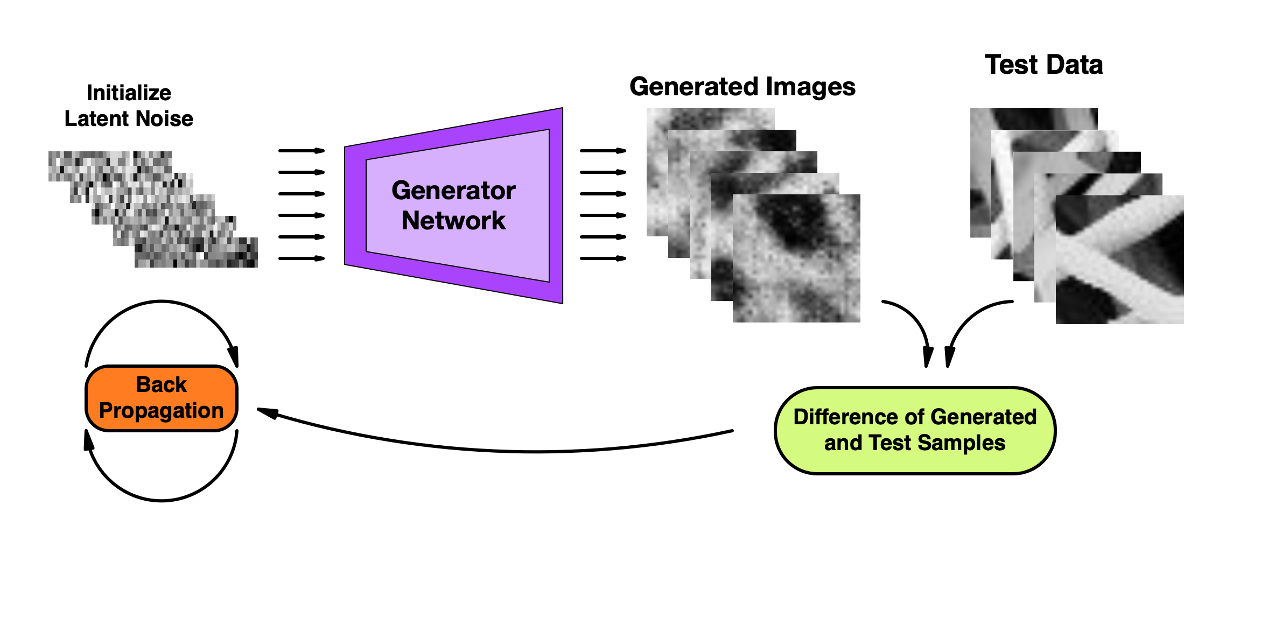
GAN Based Anomaly Detection Models
GAN training + latent representation learning
AnoGAN* → Approximation of latent representation
Slow testing performance
* Thomas Schlegl et al. “Unsupervised Anomaly Detection with Gen- erative Adversarial Networks to Guide Marker Discovery”. In: IPMI. 2017.
16
POLITECNICO DI MILANO
Notes:
First one is approximation of latent representation
Anogan Model performs classic GAN training during the training stage.
At the test stage, it uses trained generator to perform back propagation to approximate the latent representation for each given patch.
Drawback of this method is that considering an image can consist of hundreds maybe thousands of patches
Anomaly detection on a image becomes a really slow operation and not suitable for real time anomaly detection.
Also experiments show that approximated latent representations don’t provide visually similar reconstruction suitable for our anomaly detection method.

Slide 20
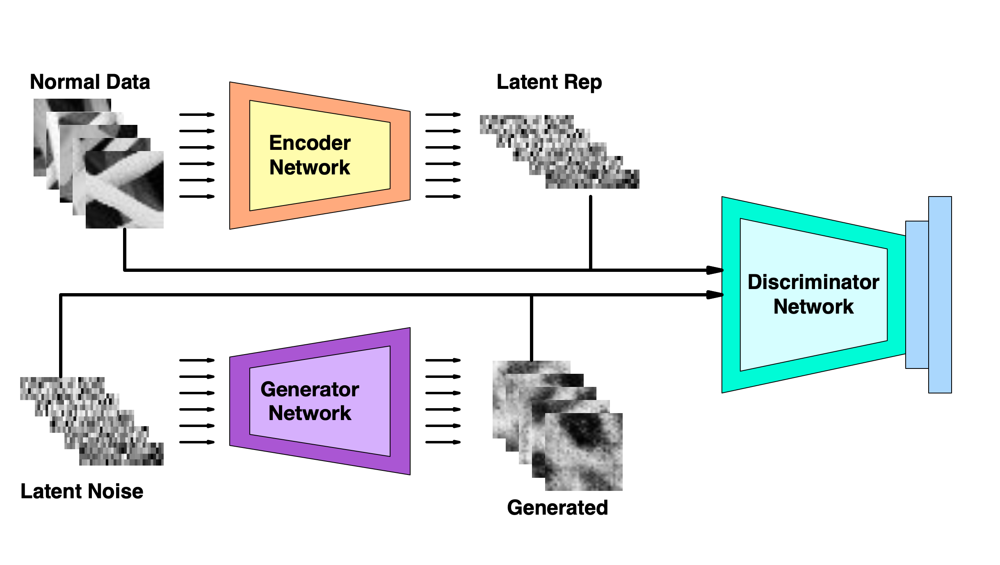
GAN Based Anomaly Detection Models
GAN training + latent representation learning
AnoGAN → Approximation of latent representation
BiGAN¹, ALAD² → Adversarial feature learning using Encoder network
Convergence & Stabilization problems
1 -Jeff Donahue, Philipp Krähenbühl, and Trevor Darrell. “Adversarial Feature Learning”. In: CoRR abs/1605.09782 (2017).
2 - Houssam Zenati et al. “Adversarially Learned Anomaly Detection”. In: CoRR abs/1812.02288 (2018). arXiv: 1812.02288. url: http: //arxiv.org/abs/1812.02288.
17
POLITECNICO DI MILANO
Notes:
Another approach is to learn the inverse mapping using an encoder network.
BiGAN and ALAD models include encoder to the adversarial training stage
Encoder is trained to learn the mapping from image space to latent space as generator learns the inverse.
Main disadvantage is that including encoder to the adversarial training can cause stabilization and convergence problems which consequently affects the reconstruction quality
Our implementations of these models didn’t manage to learn dataset well enough to obtain a good reconstruction.

Slide 21
Proposed Model (SENCEBGAN)
POLITECNICO DI MILANO
Notes:
Considering these problems, we propose an improved model

Slide 22
Proposed Model
Energy Based GAN for more stable training
18
POLITECNICO DI MILANO
Notes:
That consist of a different GAN architecture to provide more stable training.

Slide 23
Proposed Model
Energy Based GAN for more stable training
Encoder networks for latent representations of inputs and their reconstructions.
19
POLITECNICO DI MILANO
Notes:
And 2 separate encoder networks to learn the latent representation of both image and its reconstruction.

Slide 24
Proposed Model
Energy Based GAN for more stable training
Encoder networks for latent representations of inputs and their reconstructions.
Sequential training to ensure convergence
20
POLITECNICO DI MILANO
Notes:
Model trains these encoders sequentially to mitigate the convergence problems of the networks

Slide 25
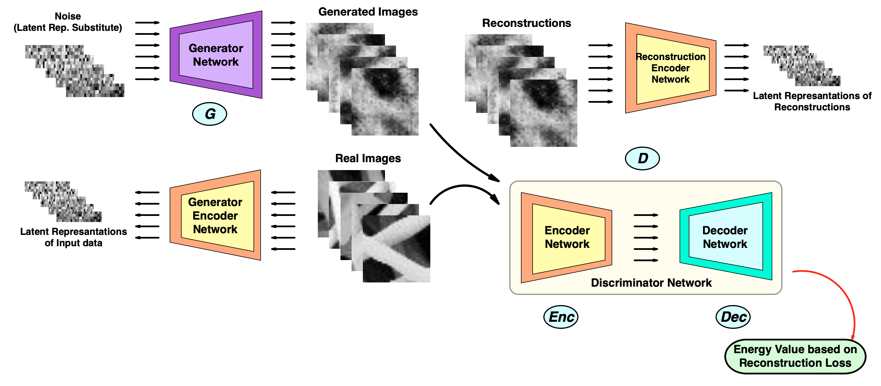
Proposed Model
Energy Based GAN for more stable training
Encoder networks for latent representations of inputs and their reconstructions.
Sequential training to ensure convergence
21
POLITECNICO DI MILANO
Notes:
Main diagram of the model is shown in the slide

Slide 26
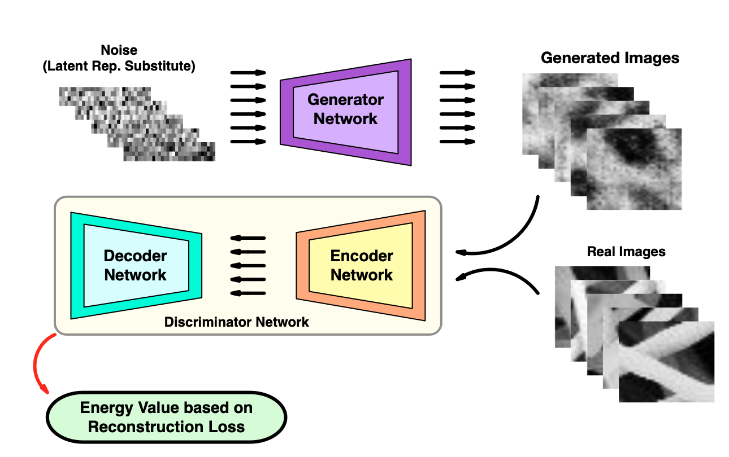
Energy Based Generative Adversarial Network
Discriminator Network becomes autoencoder network
Energy is the Reconstruction error
22
POLITECNICO DI MILANO
Notes:
First part of the model , energy based GAN is an alternative method to train the GAN framework in a more stable way
Discriminator is modeled as autoencoder and instead of attaining probability about data being real or fake
It computes and energy score using its internal reconstruction
According to this new adversarial setting, normal images should output a lower energy while generated data outputs a higher energy value
Because energy is computed using the reconstruction difference

Slide 27
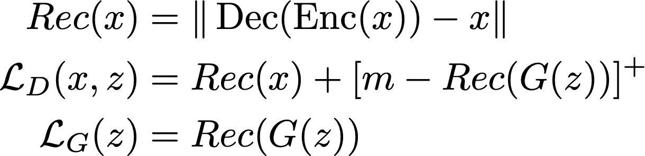
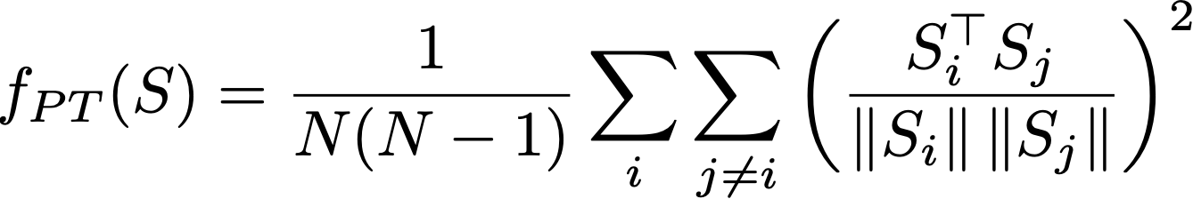
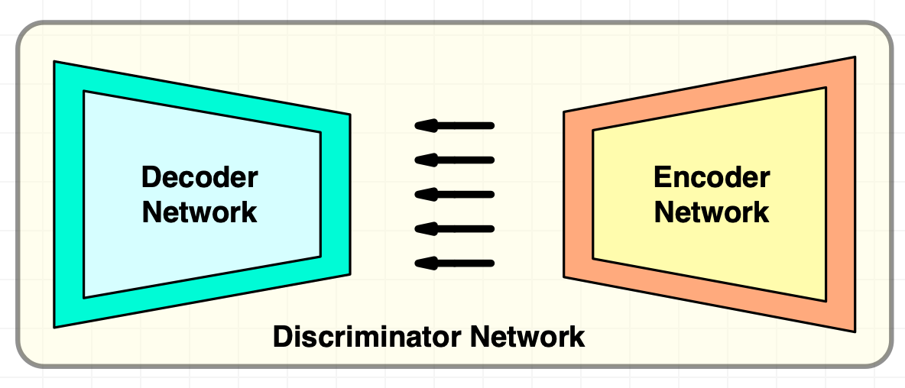
Energy Based Generative Adversarial Network
Energy based value function based on margin loss
Reconstruction based output offers a diverse output for discriminator
Discriminator regularization by generator network
Pulling away term mitigates the mode collapse problem
23
POLITECNICO DI MILANO
Notes:
Formally, discriminator network assigns energy score with This reconstruction operation
From the discriminator’s perspective, it needs to minimize the terms it assigns to real and fake images for its loss
Margin value m defines a higher energy band for fake images so discriminator maximizes the energy score for fake images by minimizing the term
Generator is trained to generate samples that discriminator assigns low energy
Additional pull away loss f_pt is also added to the training.
This applies a penalty to generator using the latent representation of discriminator during training in case the generated samples becomes too similar.
This helps generator to learn to generate more diverse samples

Slide 28
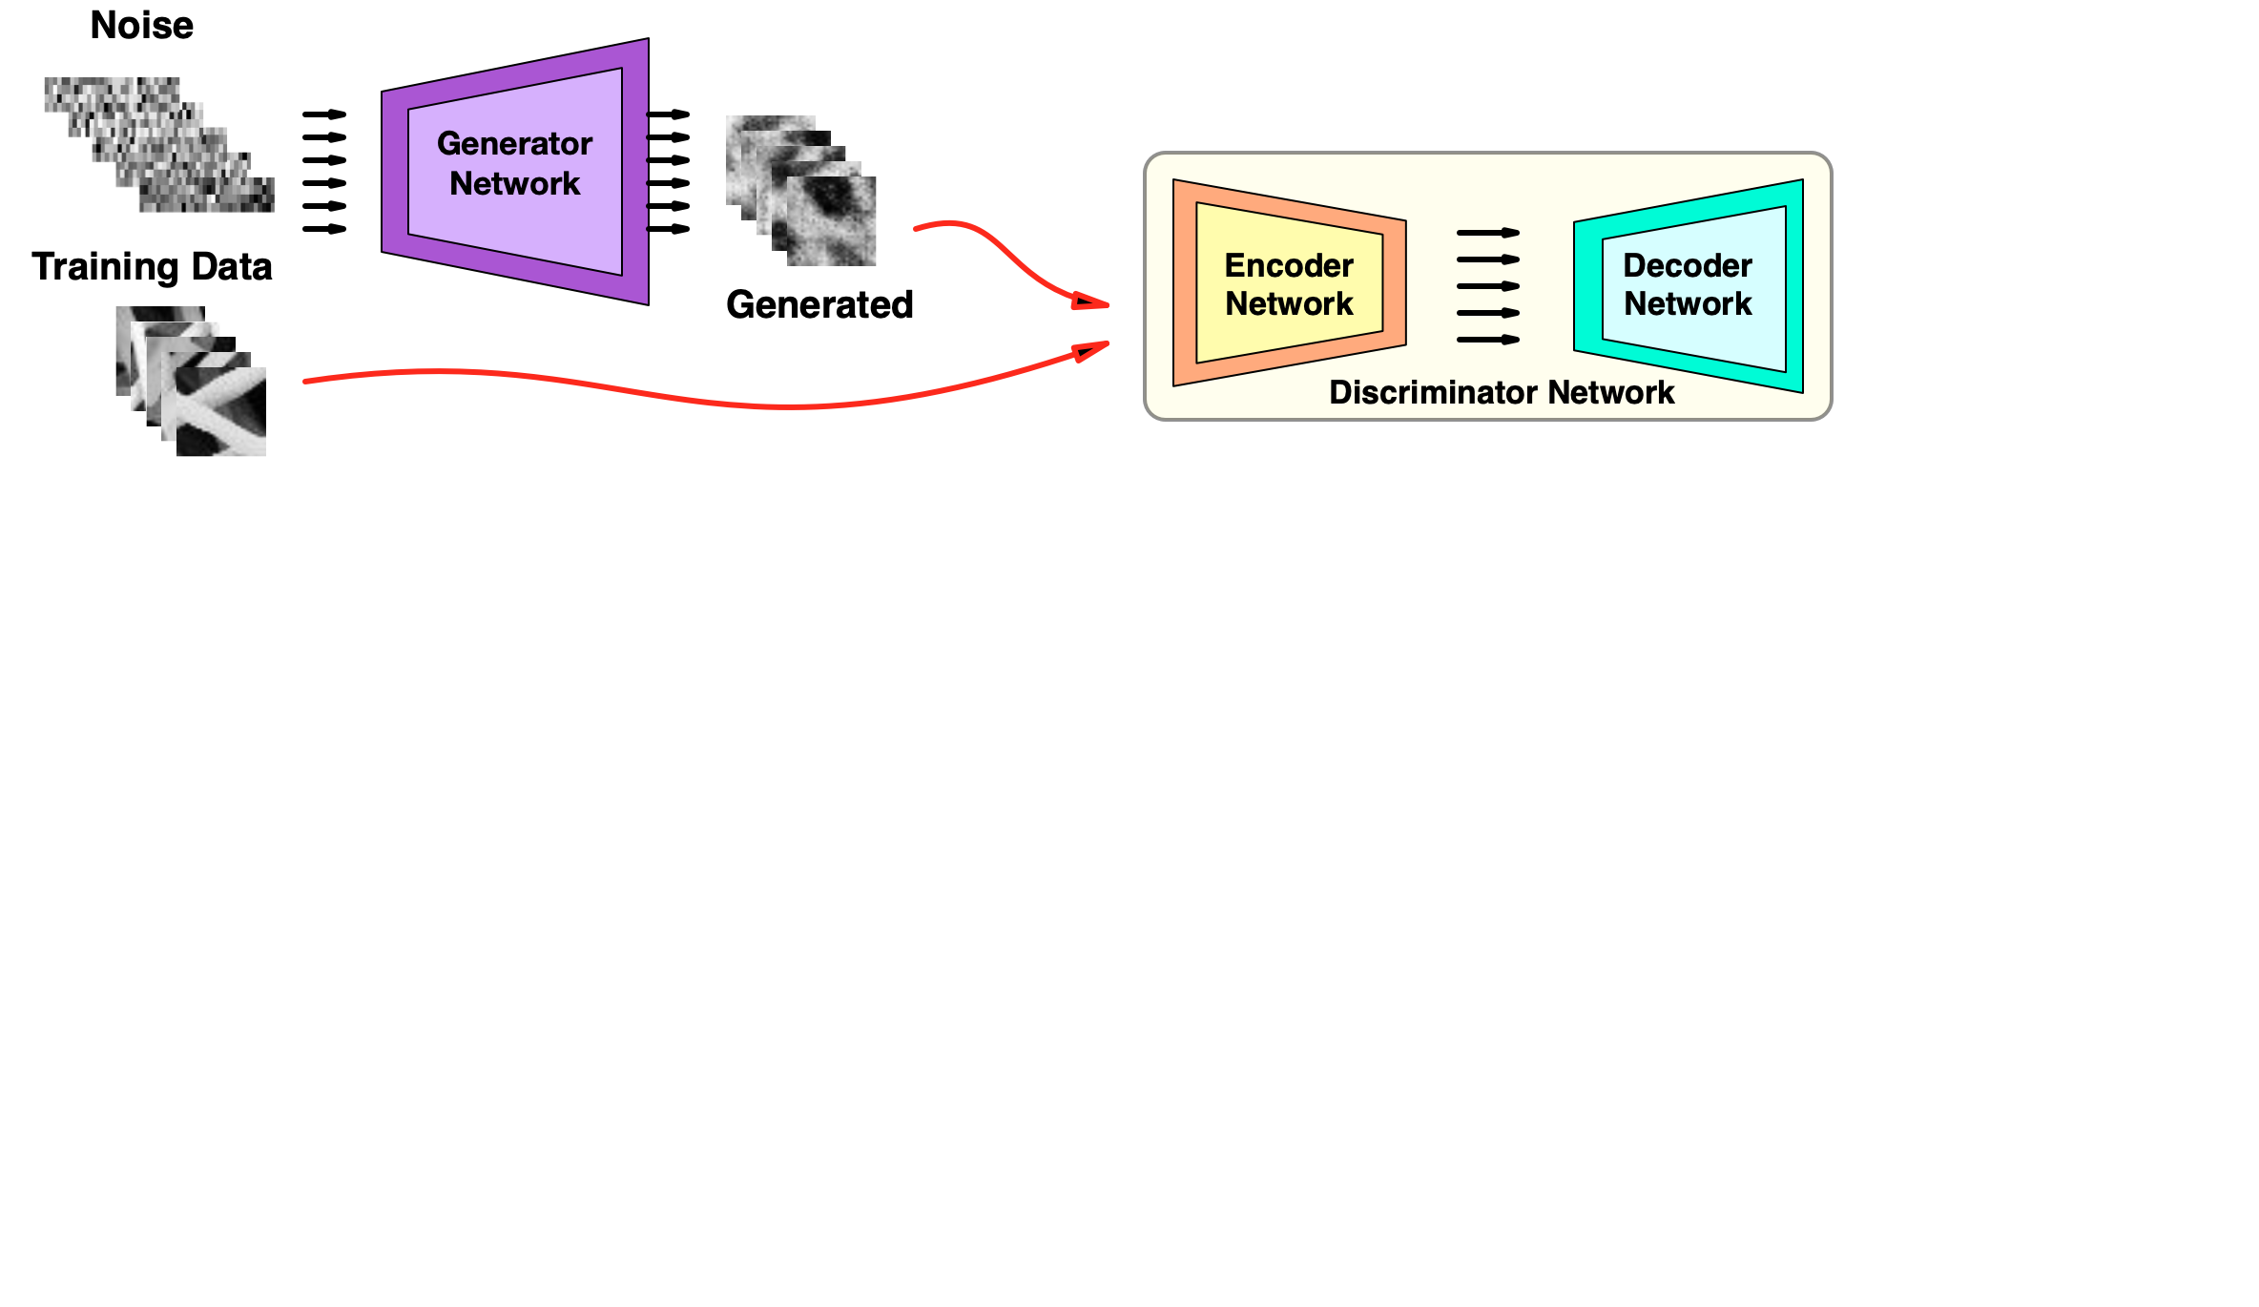
Training of the Model – Stage 1
Initial stage is energy based GAN training
24
POLITECNICO DI MILANO
Notes:
As mentioned before training of the model is sequential and composed of three stages,
In first stage the energy based GAN is trained with the training data and learns the mapping between the latent space and image space

Slide 29
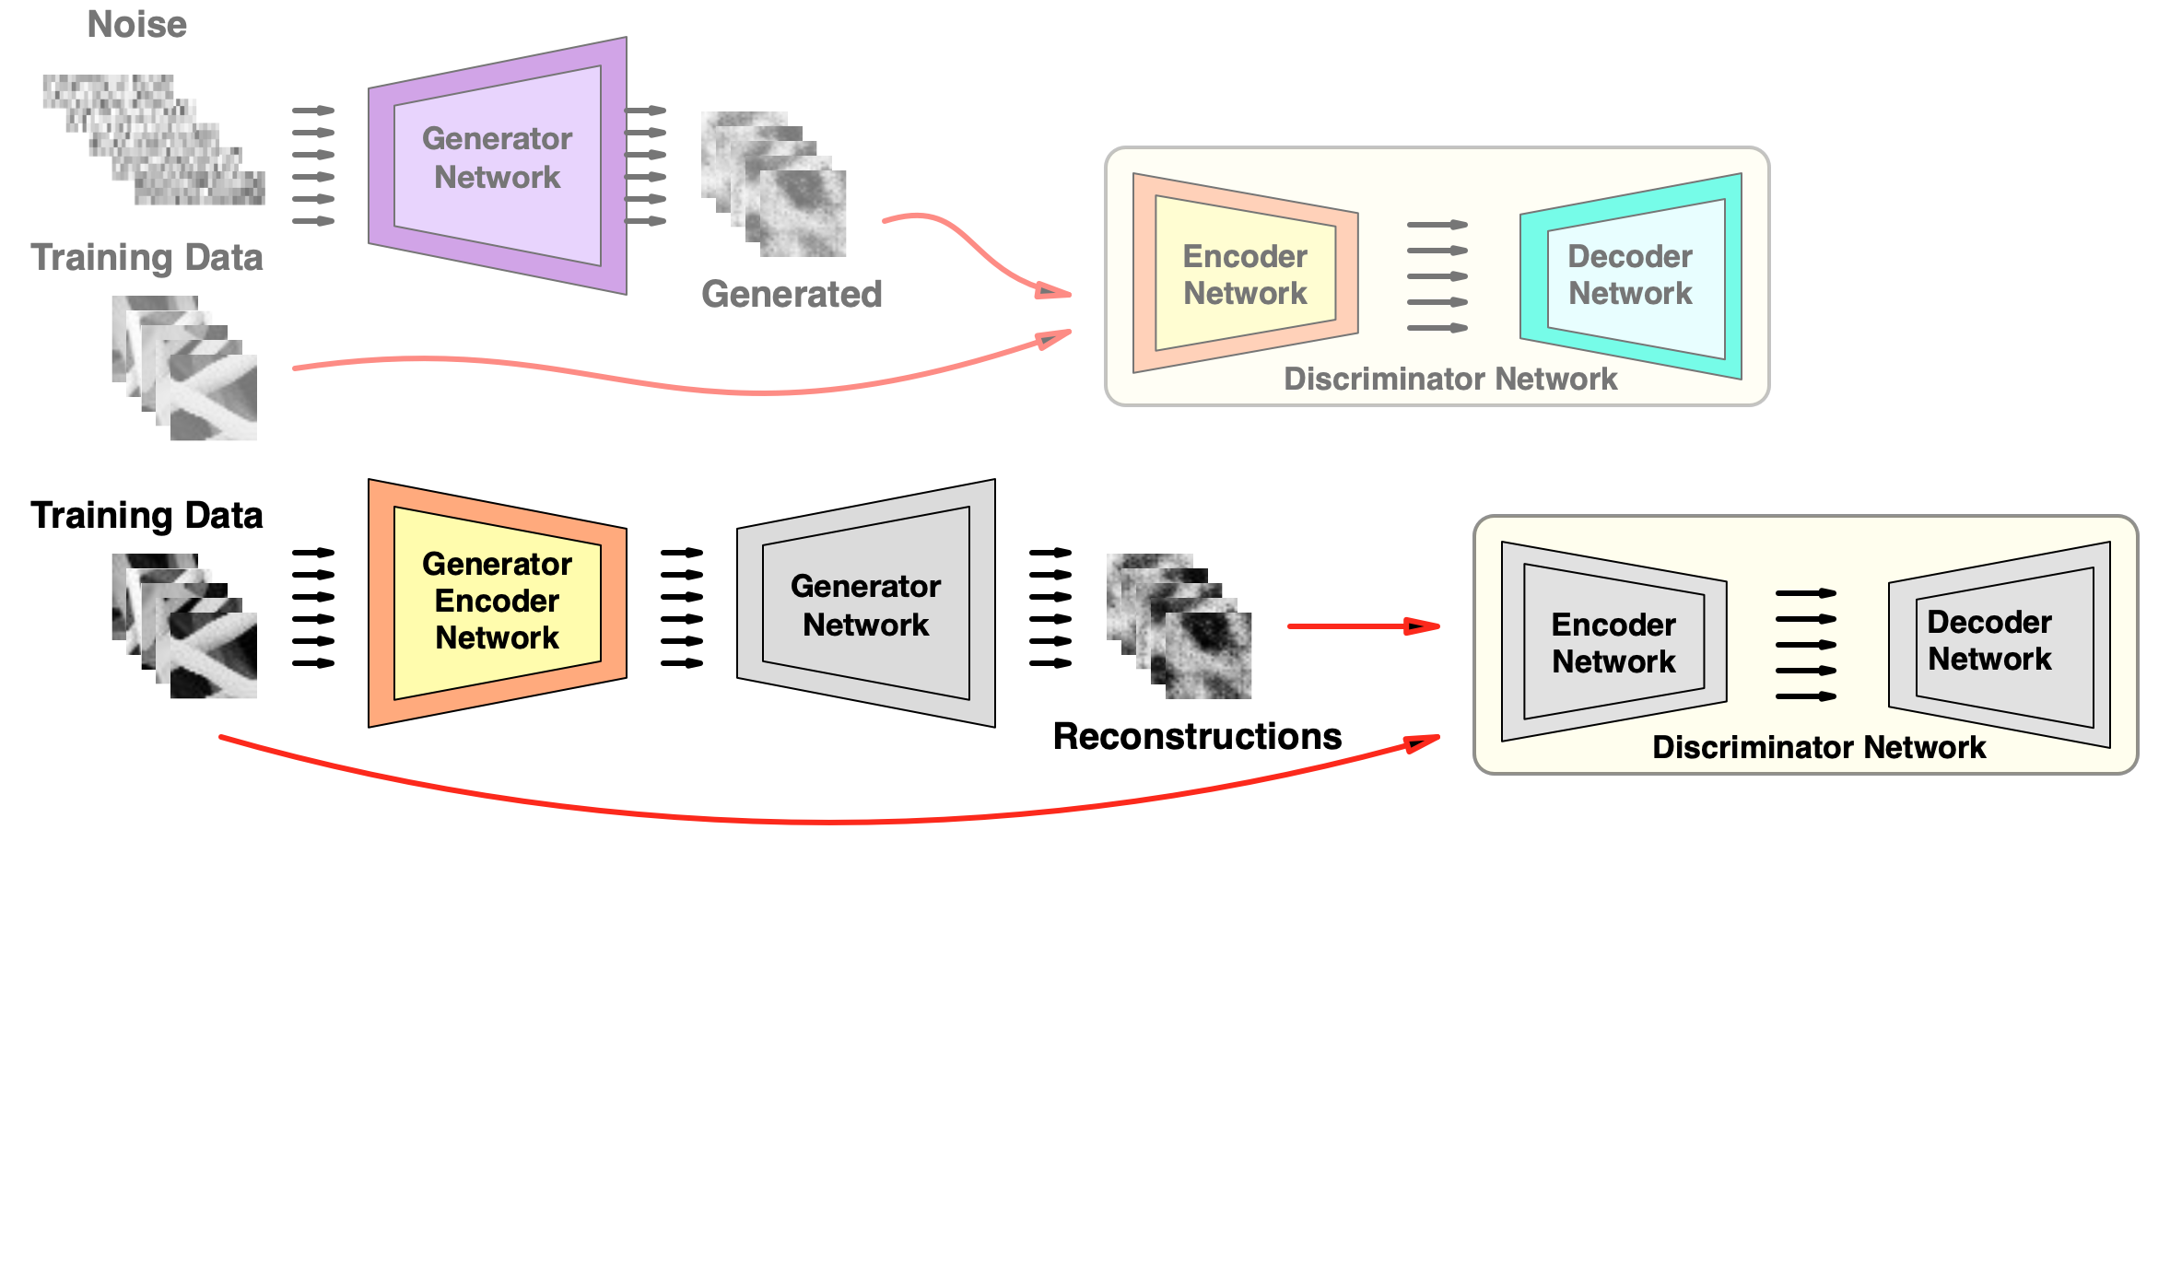
Training of the Model – Stage 2
Generator Encoder training for bi directional mapping
25
POLITECNICO DI MILANO
Notes:
In second stage, generator encoder network learns to map from image space to latent representation
and adversarially learns the features of the images

Slide 30
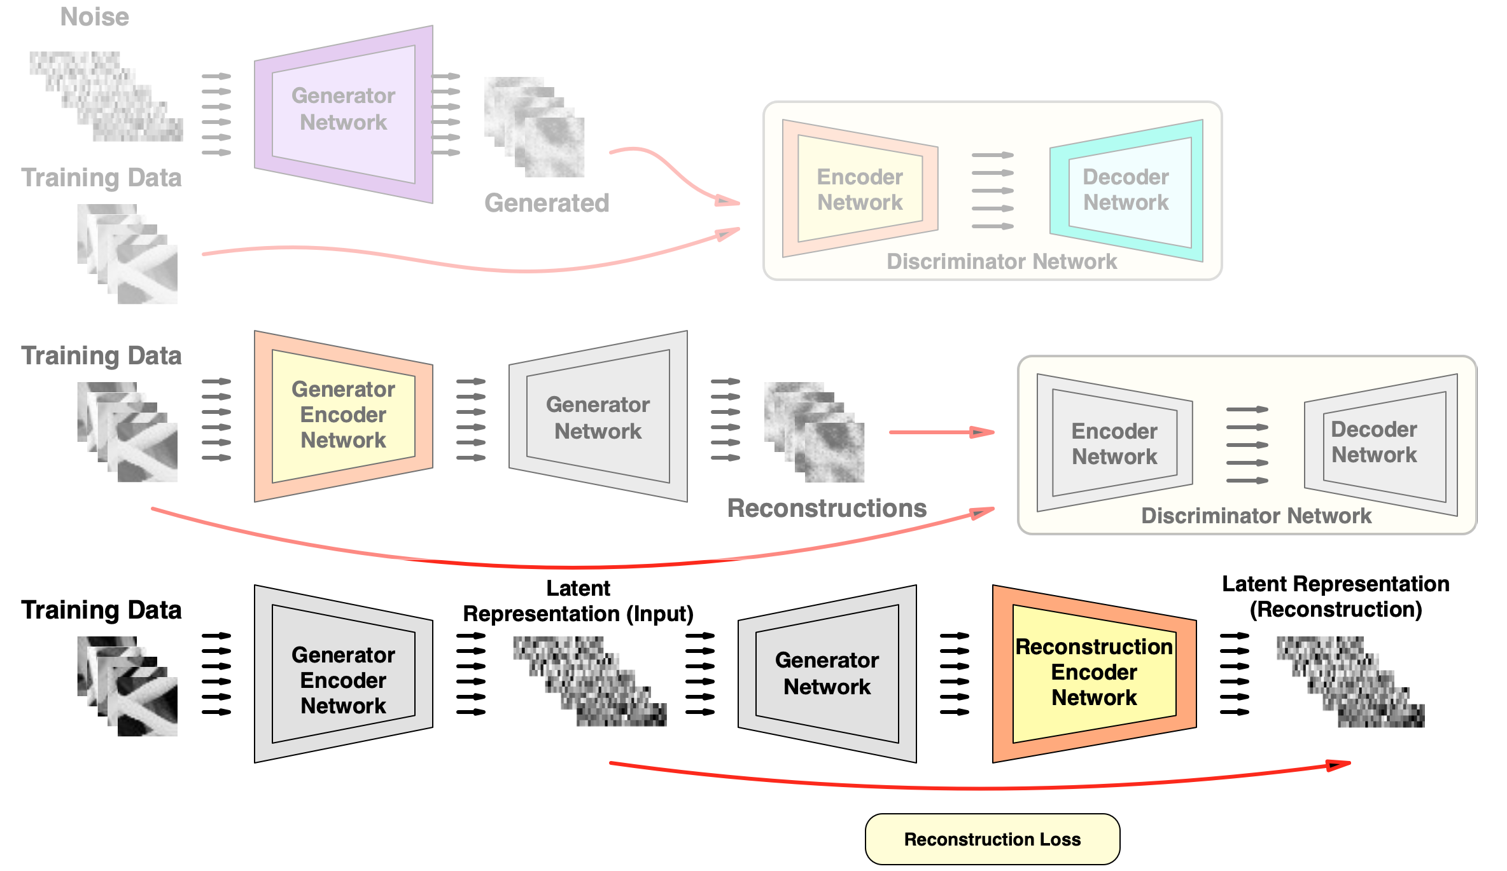
Training of the Model – Stage 3
Reconstruction Encoder training for L.R. of reconstructions
26
POLITECNICO DI MILANO
Notes:
In the final stage, the latent representation of the reconstructions are learned. We speculate that

Slide 31
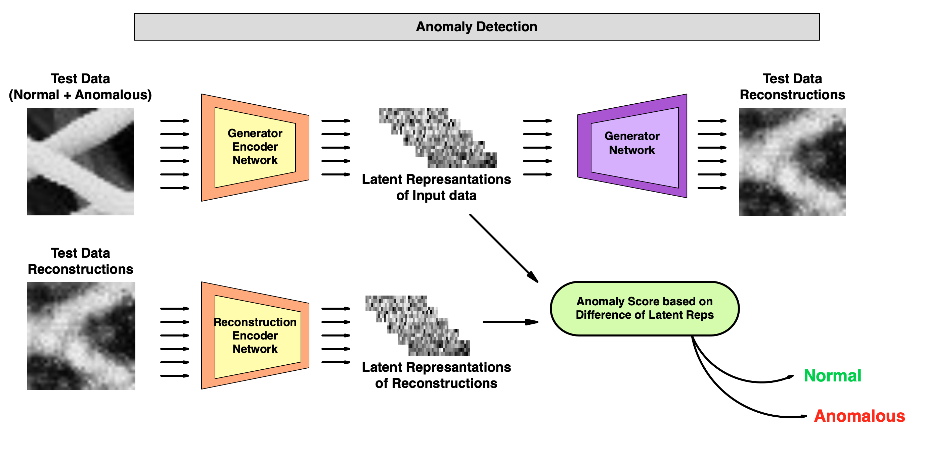
Anomaly Detection of Proposed Model ( SENCEBGAN)
27
POLITECNICO DI MILANO
Notes:
Anomaly score computation based on the latent representation rather than the image and its reconstruction provides a more reliable distinction for this problem
Our experiments show that using latent representation rather than image data provide us an improved performance

Slide 32
Experiments & Results
POLITECNICO DI MILANO
Notes:
Now I will present our experiment results

Slide 33
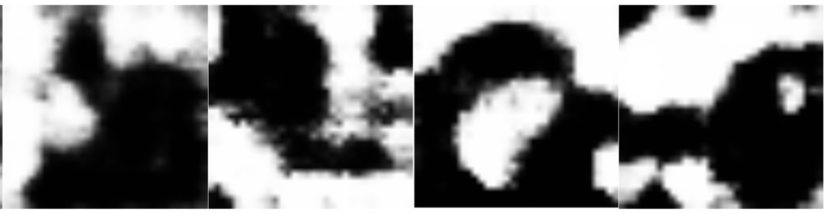
Generator Image Generation Comparison
Generated samples from AnoGAN, BiGAN and ALAD
28
POLITECNICO DI MILANO
Notes:
First results compares the generator capacity in the models
This batch shows the generator ‘s sample quality of models in the literature after the training.
Generated image data does not resemble our training data.

Slide 34
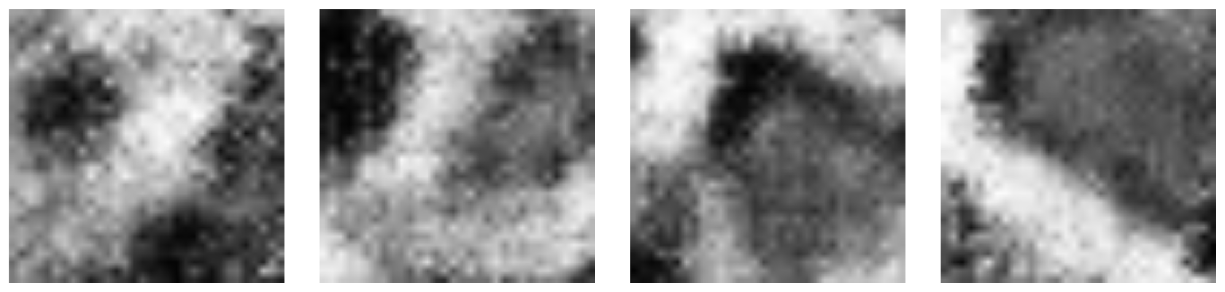
Generator Image Generation Comparison
Generated samples from AnoGAN, BiGAN and ALAD
Generated samples from proposed model (SENCEBGAN)
29
POLITECNICO DI MILANO
Notes:
These are the generation results of energy based GAN of our model. They present a more visually similar image generations

Slide 35
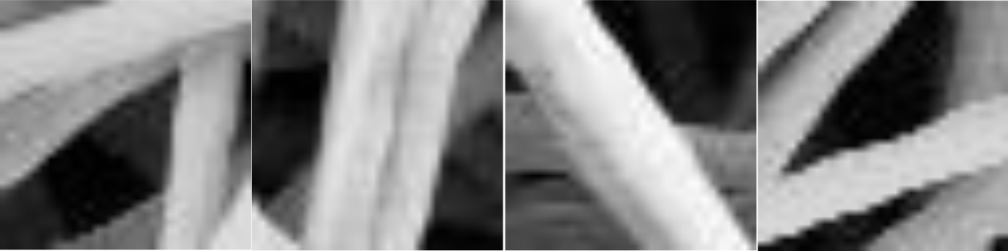
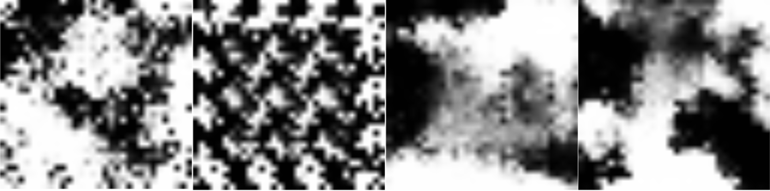
Reconstruction Quality Comparison
Reconstruction samples from AnoGAN, BiGAN and ALAD
30
POLITECNICO DI MILANO
Notes:
Next we compare the reconstruction quality of the models
These are the results from the models in literature

Slide 36
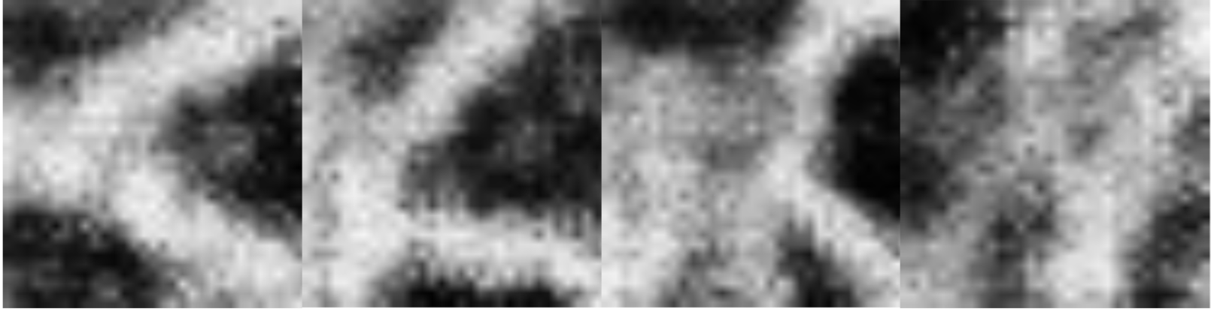
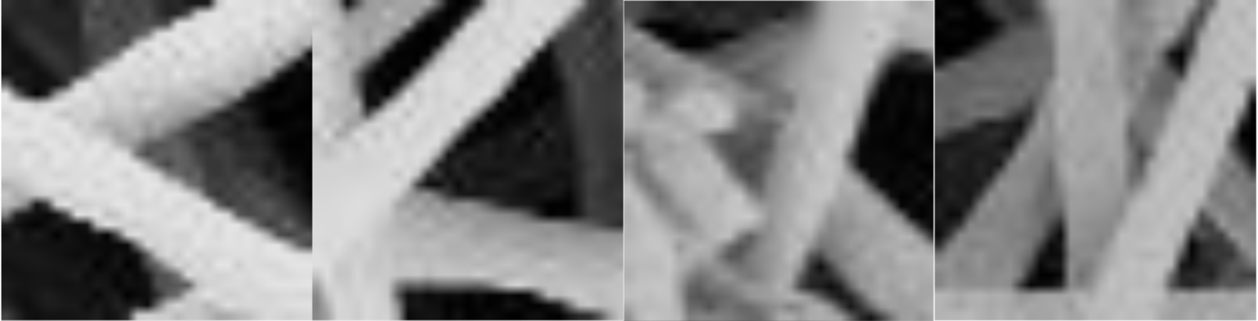
Reconstruction Quality Comparison
Reconstruction samples from AnoGAN, BiGAN and ALAD
Reconstruction samples from proposed model (SENCEBGAN)
31
POLITECNICO DI MILANO
Notes:
And these are the reconstruction sample from our model

Slide 37
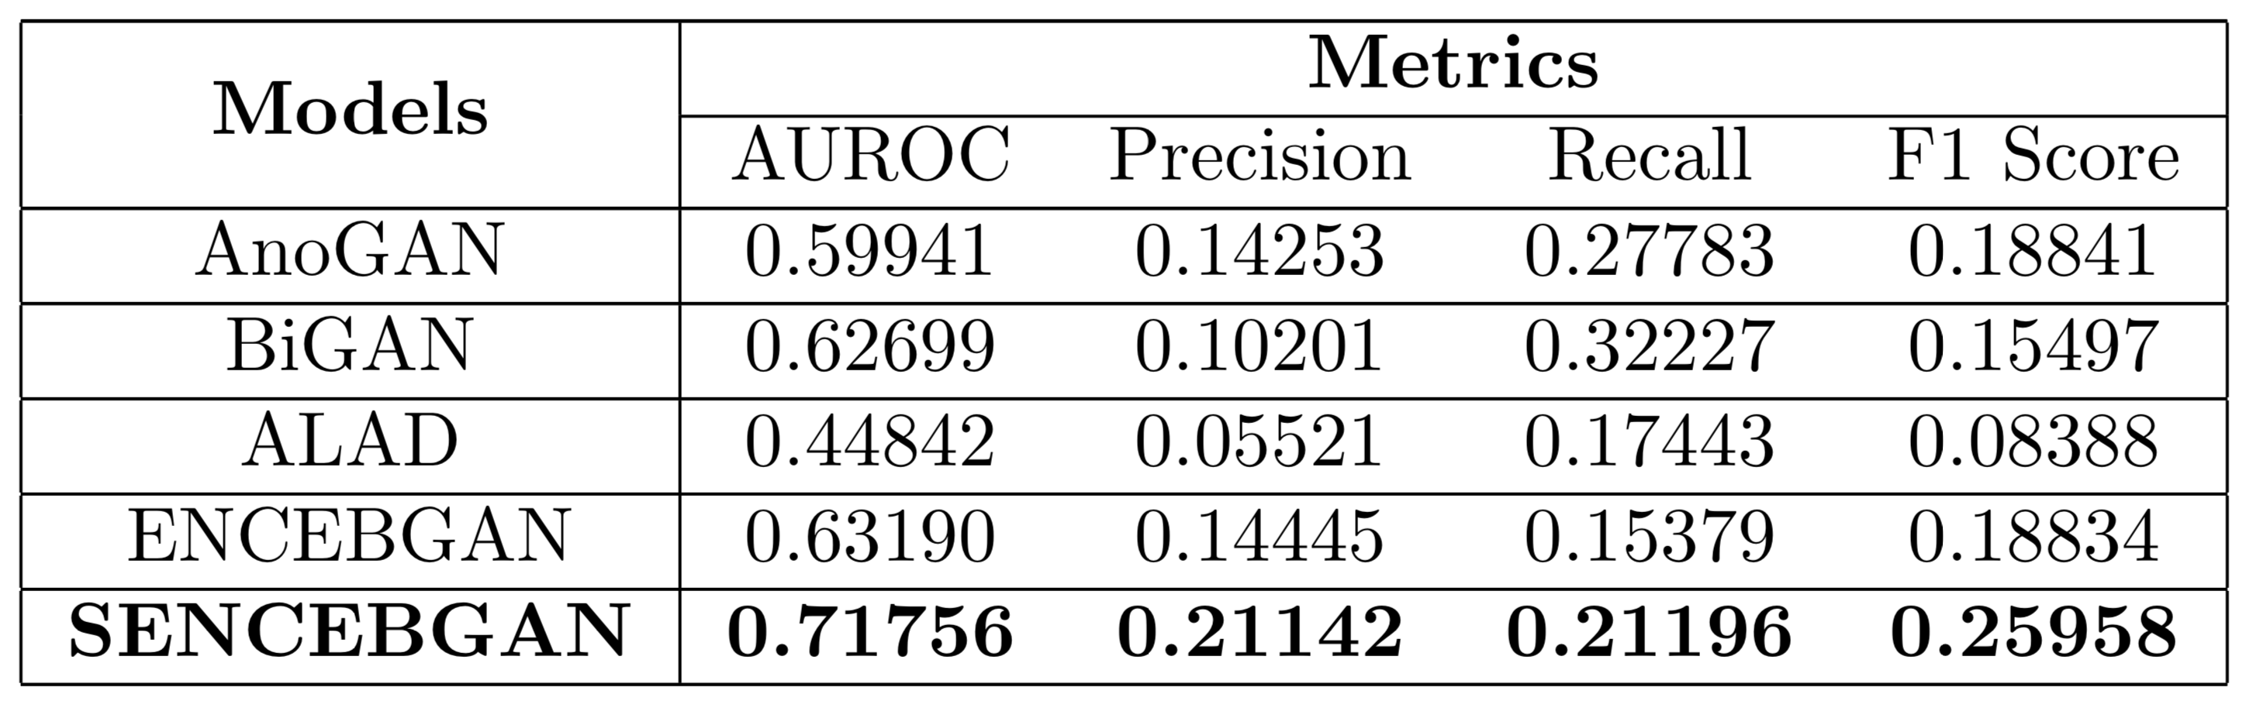
Performance Comparison
ENCEBGAN : Second encoder not trained, anomaly score based on image and reconstruction
SENCEBGAN : Latent representation based anomaly score
32
POLITECNICO DI MILANO
Notes:
This table shows the overall performance of the models
All models are implemented from scratch and tested with our dataset
Anomaly score based on image data is also tested with ENCEBGAN model
Overall our model marginally improved the performance on anomaly detection and visual quality of reconstructions

Slide 38
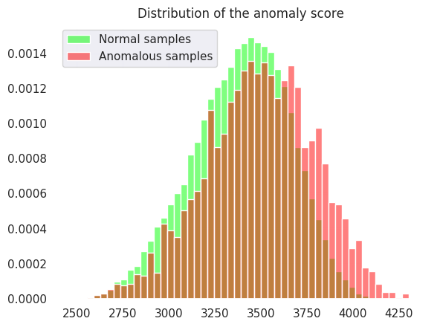
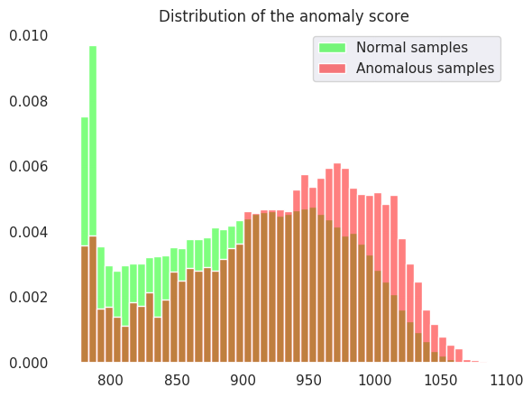
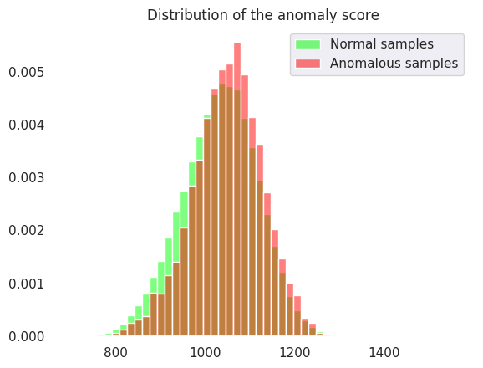
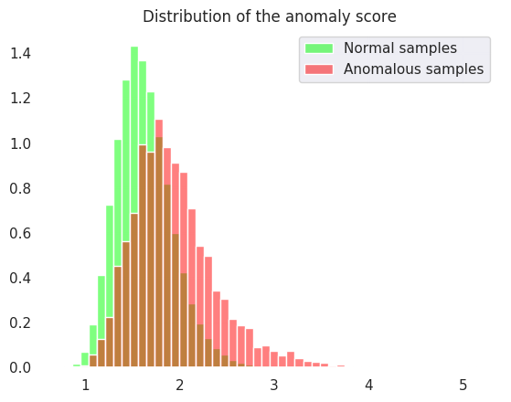
Seperation of Anomalies
AnoGAN
BiGAN
ALAD
Proposed Model
33
POLITECNICO DI MILANO
Notes:
These histograms shows the separation of normal and anomalous patches w.r.t to their assigned anomaly score.

Slide 39
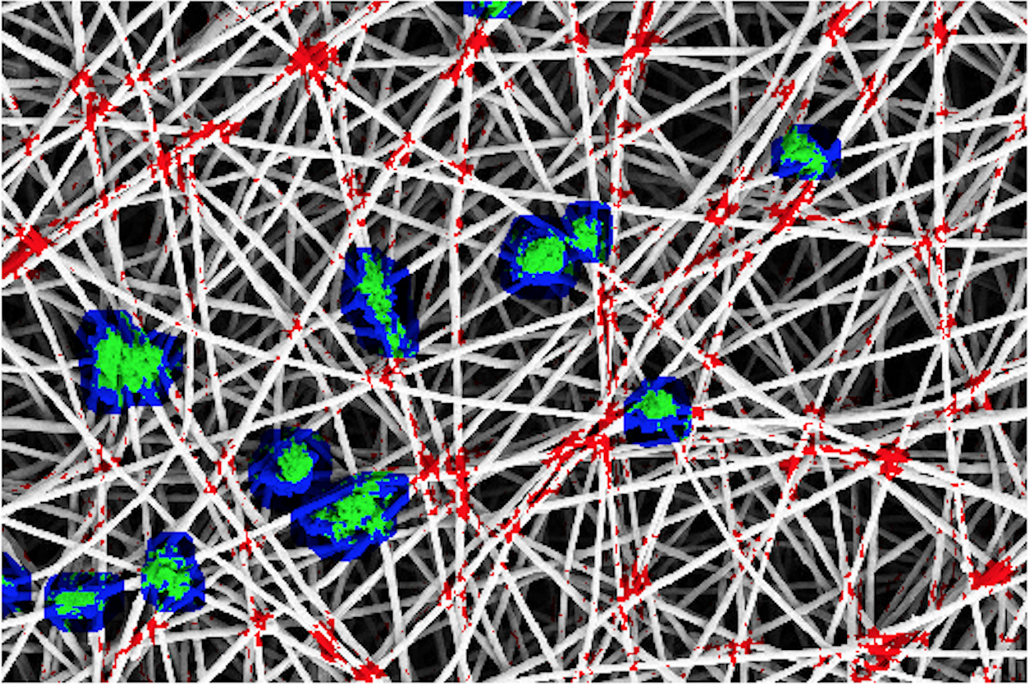
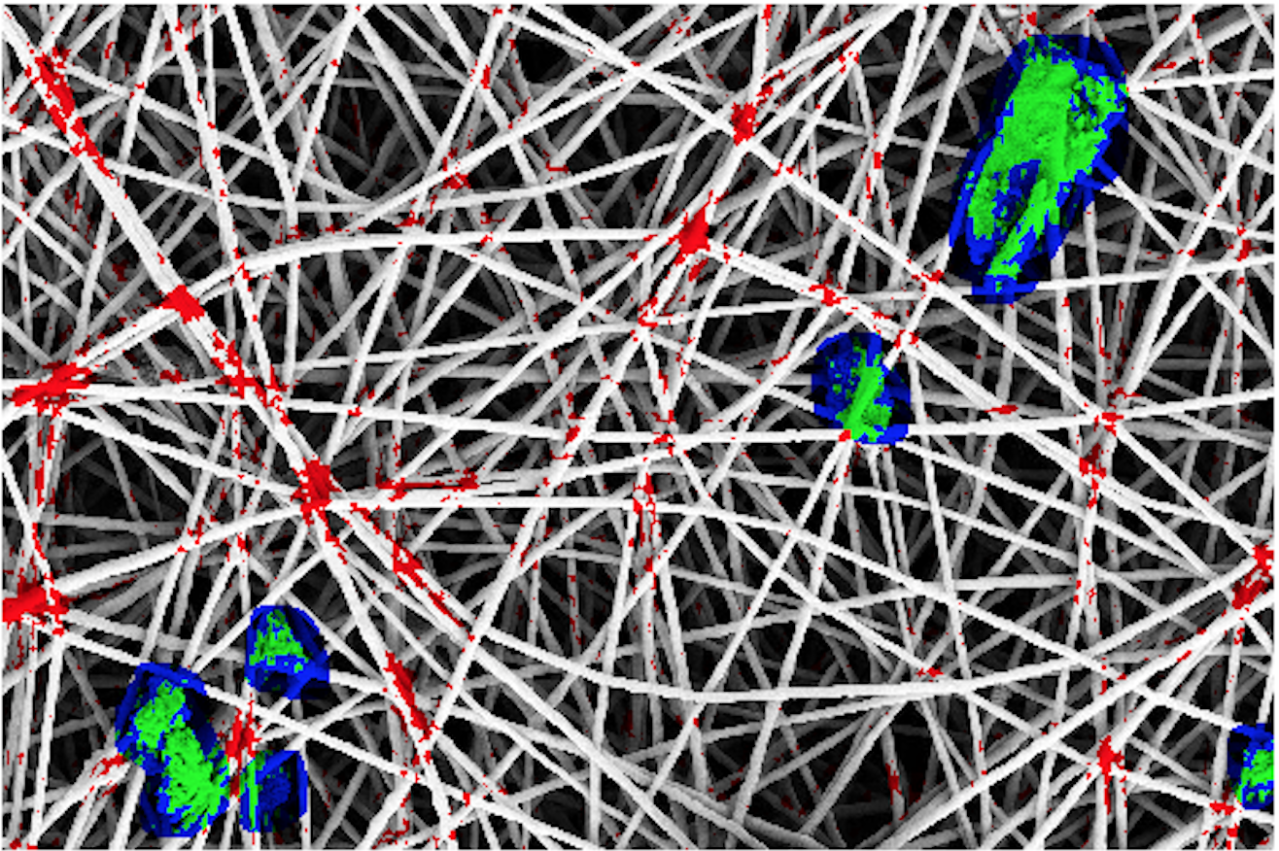
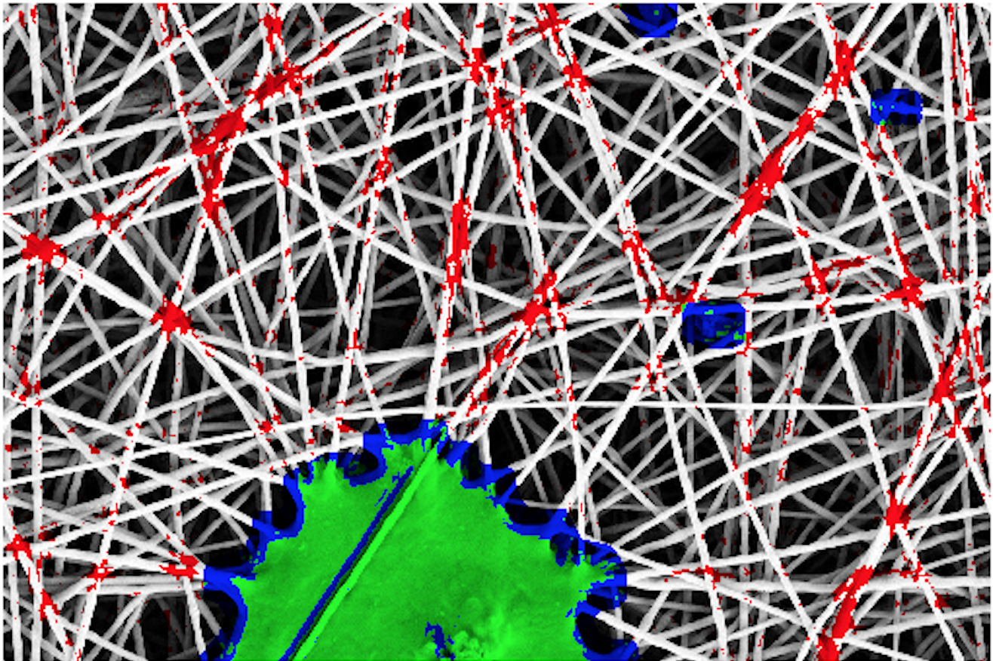
Anomaly Detection on Image
Pixelwise Anomaly Detection Results
34
POLITECNICO DI MILANO
Notes:
Finally, These are the results of our anomaly detection method on test images with pixelwise coloring.

Slide 40
Conclusions
In conclusion,
We proposed a model to address the anomaly detection problem in nanofibrous material production
GAN based anomaly detection shows a promise
Reconstruction quality is the key
Improving feature learning and reconstruction quality for future work
35
POLITECNICO DI MILANO
Notes:
In conclusion
In this thesis, we proposed a model to address the anomaly detection problem in nanofibrous material production.
We observe that GAN based anomaly detection shows a promise for this type of problem
Also, reconstruction quality of the GAN is the main factor that affects the performance
We speculate that Improving feature learning of the model by improving the generation quality of the GAN will prove to be more affective solution in the future

Slide 41
Thank you for your attention,
Questions ?
POLITECNICO DI MILANO

